Slide 1
RECEIPTINBOX
EE 547 – FINAL PROJECT REFERENCE DECK

Slide 2
PROJECT SUMMARY
what did I spend, on what, and when?
  Traditionally: manually transcribe receipt
ReceiptInbox
  Upload receipt to cloud
  ML-powered categorization
  Spending trends

Slide 3
ARCHITECTURE SUMMARY
Frontend
  React
Backend
  API Gateway, Lambda, DynamoDB, S3
ML Components
  Rekognition, Bedrock
Note: diagram on next slide

Slide 4
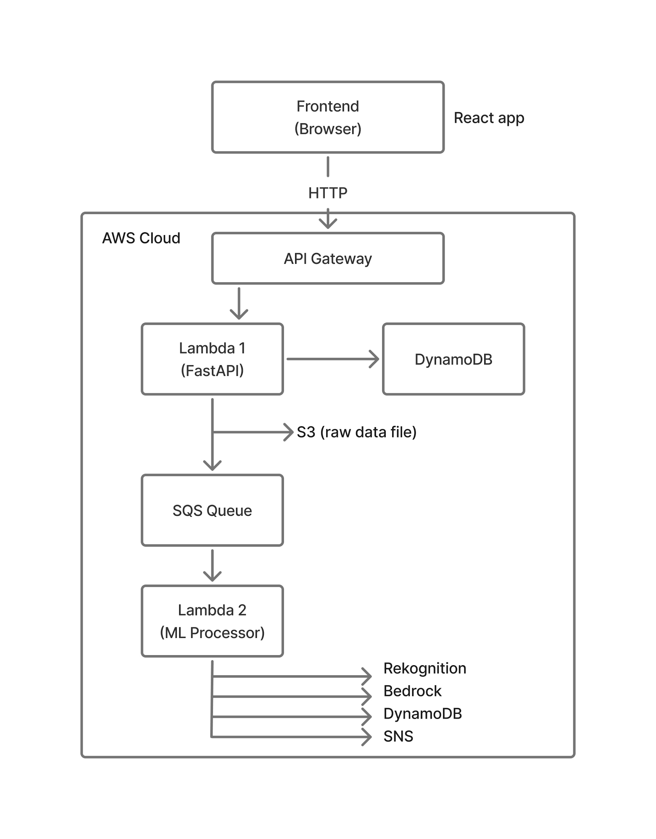
ARCHITECTURE SUMMARY
S3 (fetch image)

Slide 5
CLOUD DEPLOYMENT
Fully deployed
CLI tools
Frontend - Netlify
Backend - AWS SAM

Slide 6
TIMELINE – RETROSPECTIVE
Early stage
  Separate development: Frontend, Backend, ML
Integration
  Merge and debug
Feature enhancement
  e.g. Dashboard: single tab -> multi-tab

Slide 7
REFERENCES
ReceiptSense: Beyond Traditional OCR - A Dataset for Receipt Understanding. (2024). GitHub. Available at: https://github.com/Update-For-Integrated-Business-AI/CORU

Slide 8
FRONTEND

Slide 9
FRONTEND OVERVIEW
Core: React, React Router
UI Components: Ant Design (responsive)
Charts: Recharts (interactive visualization)
HTTP Client: Axios

Slide 10
USER ROLES
Signup (create account)
Log in/log out
Upload receipt
View spending statistics
  Categories, trends, etc.

Slide 11
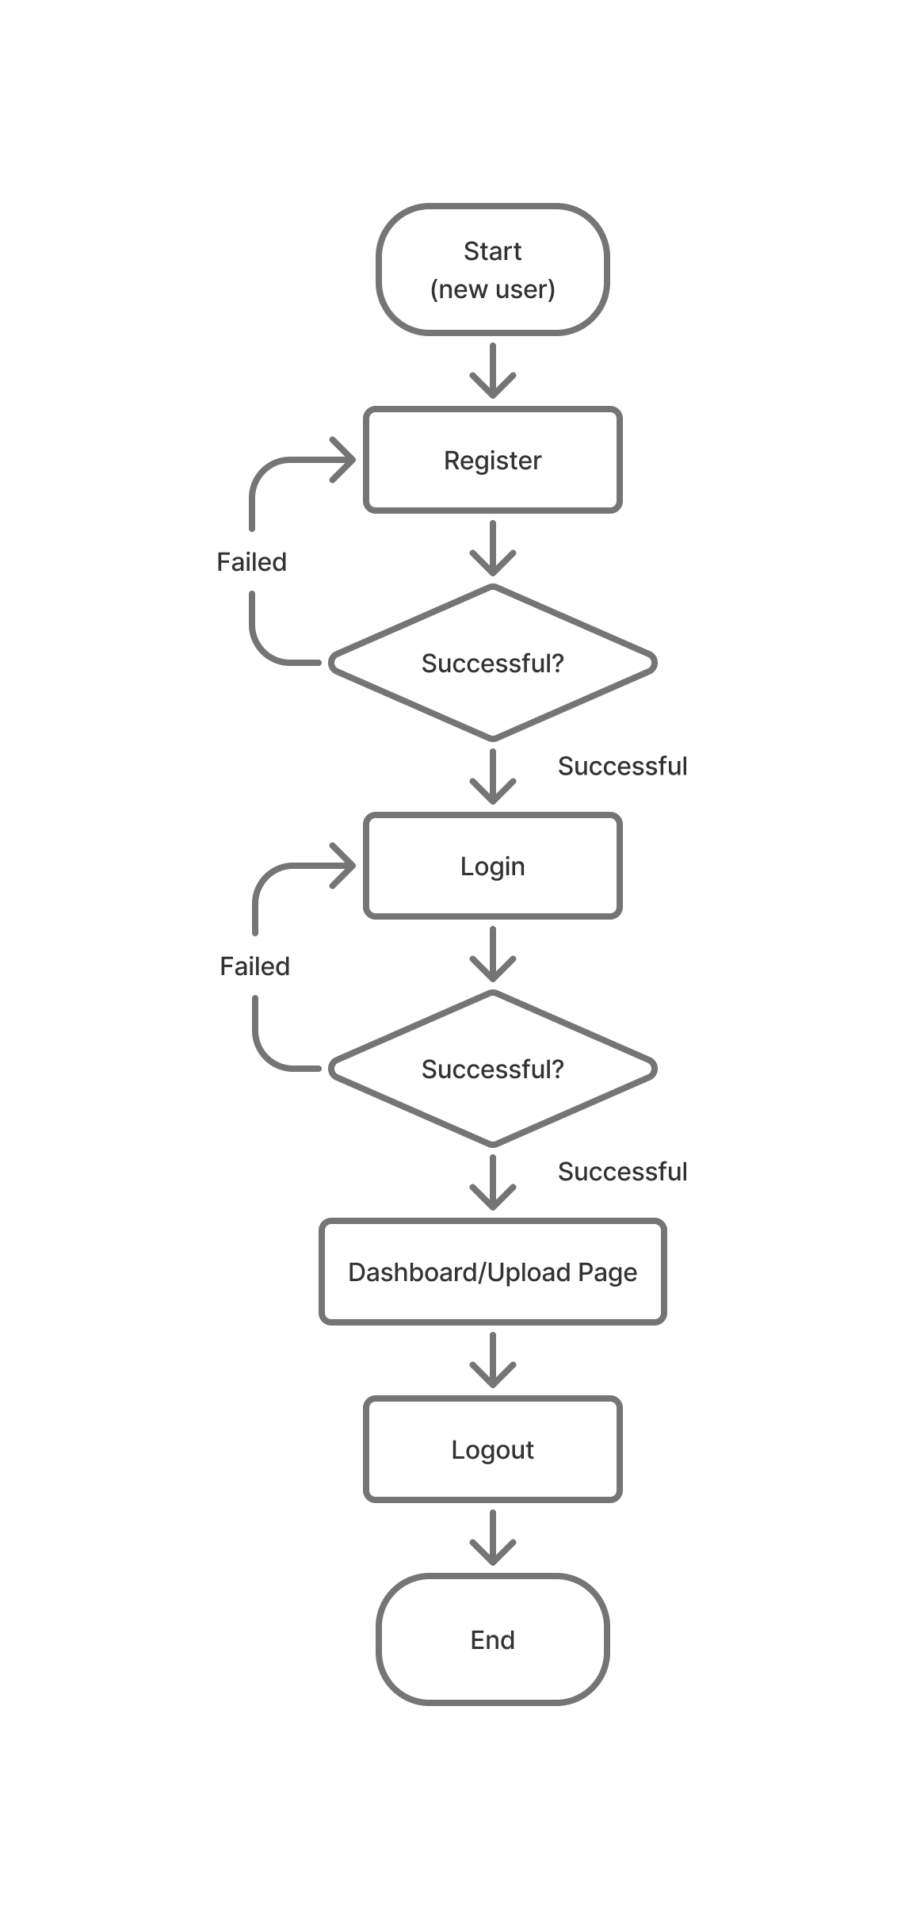
USER FLOW DIAGRAM

Slide 12

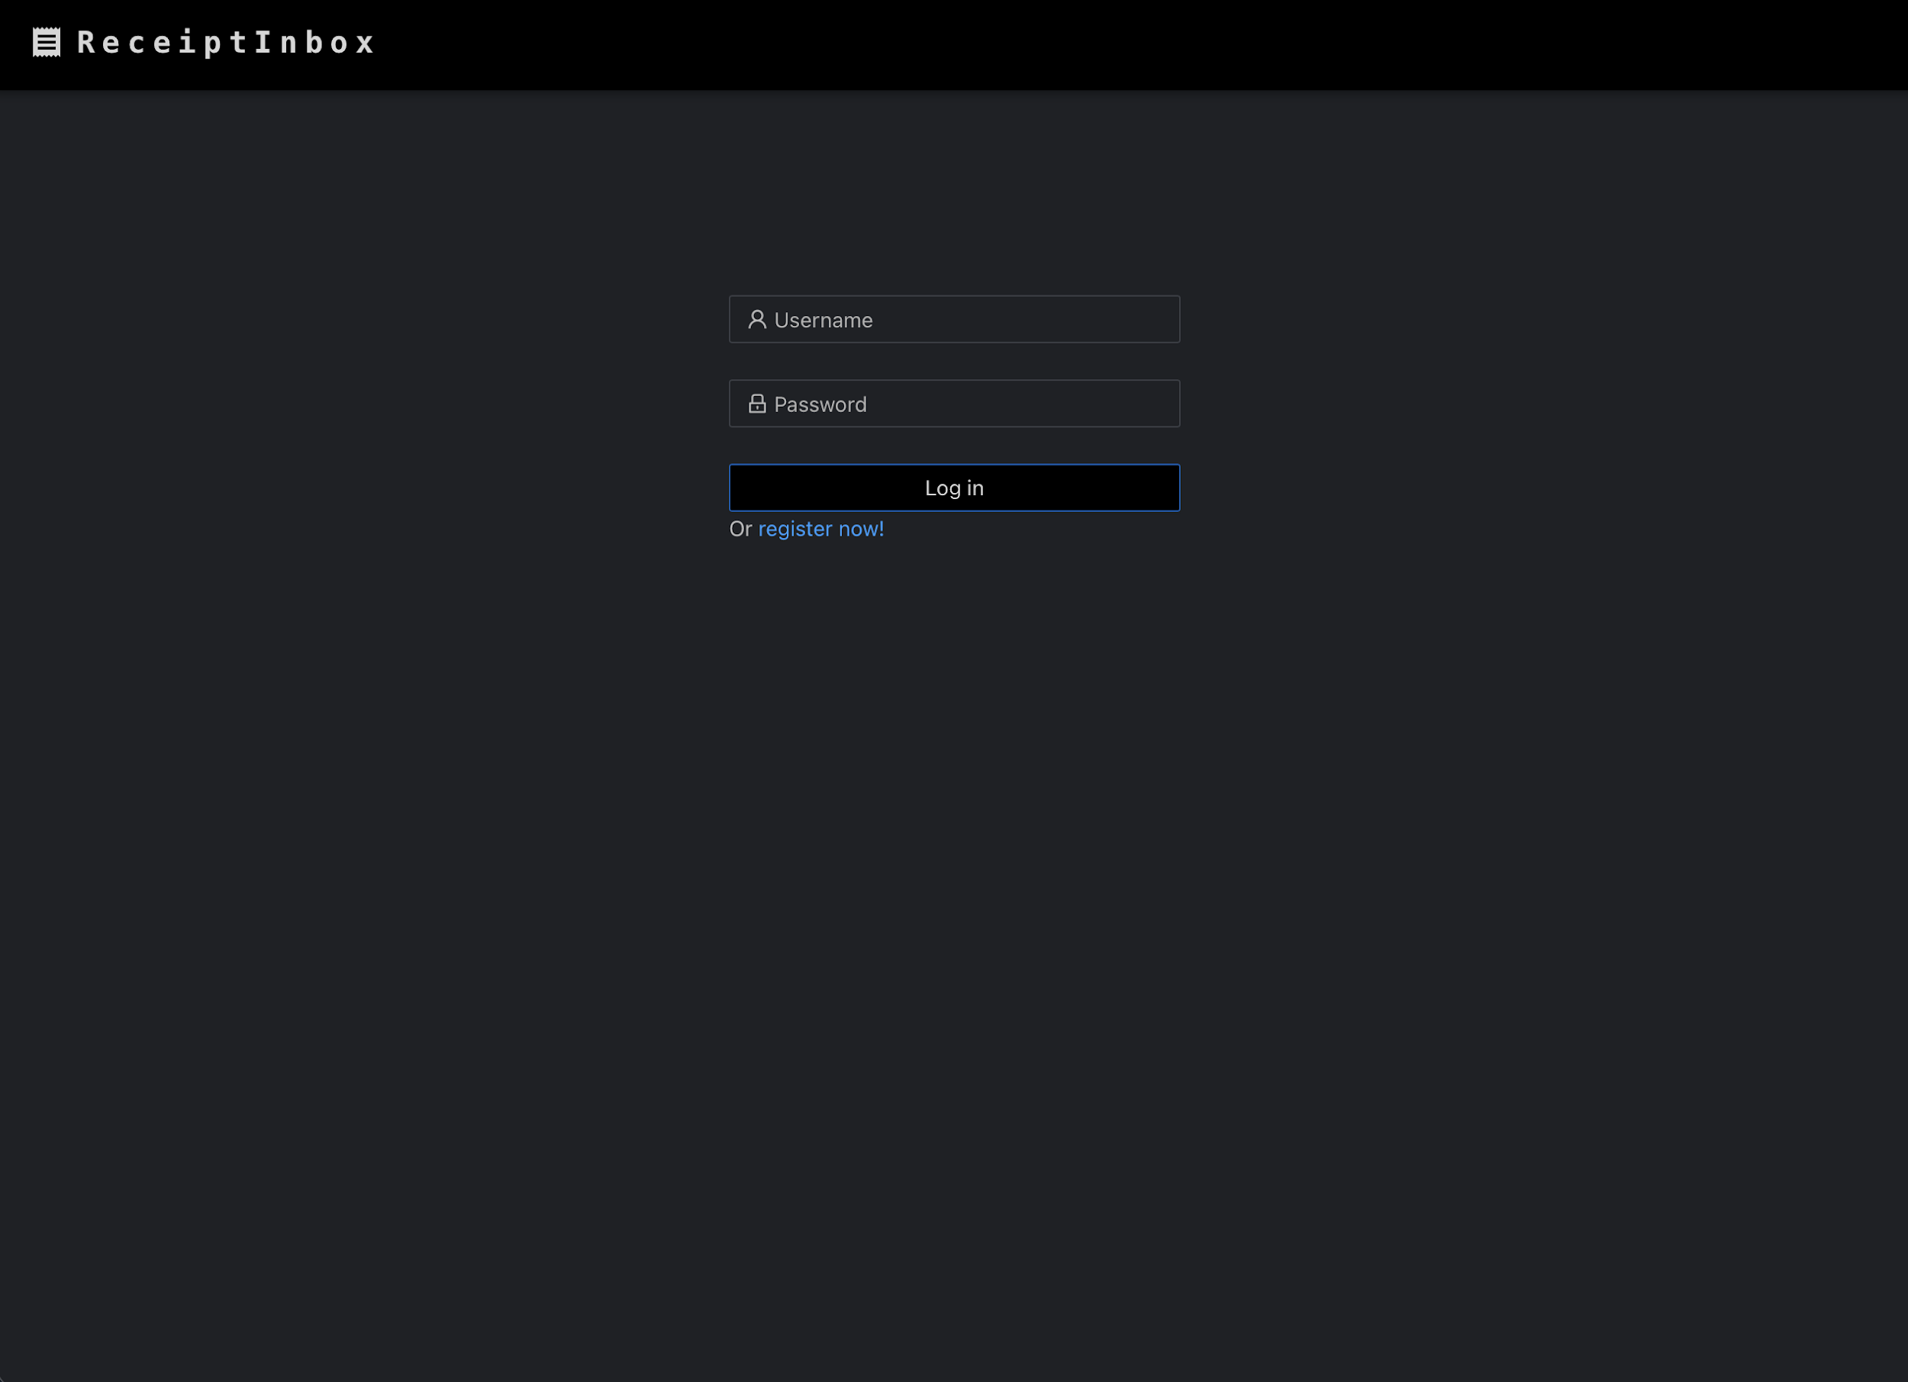
PAGE: REGISTER, LOGIN
Register page
Checks if user already exists
Login page
Returns JWT if successful

Slide 13

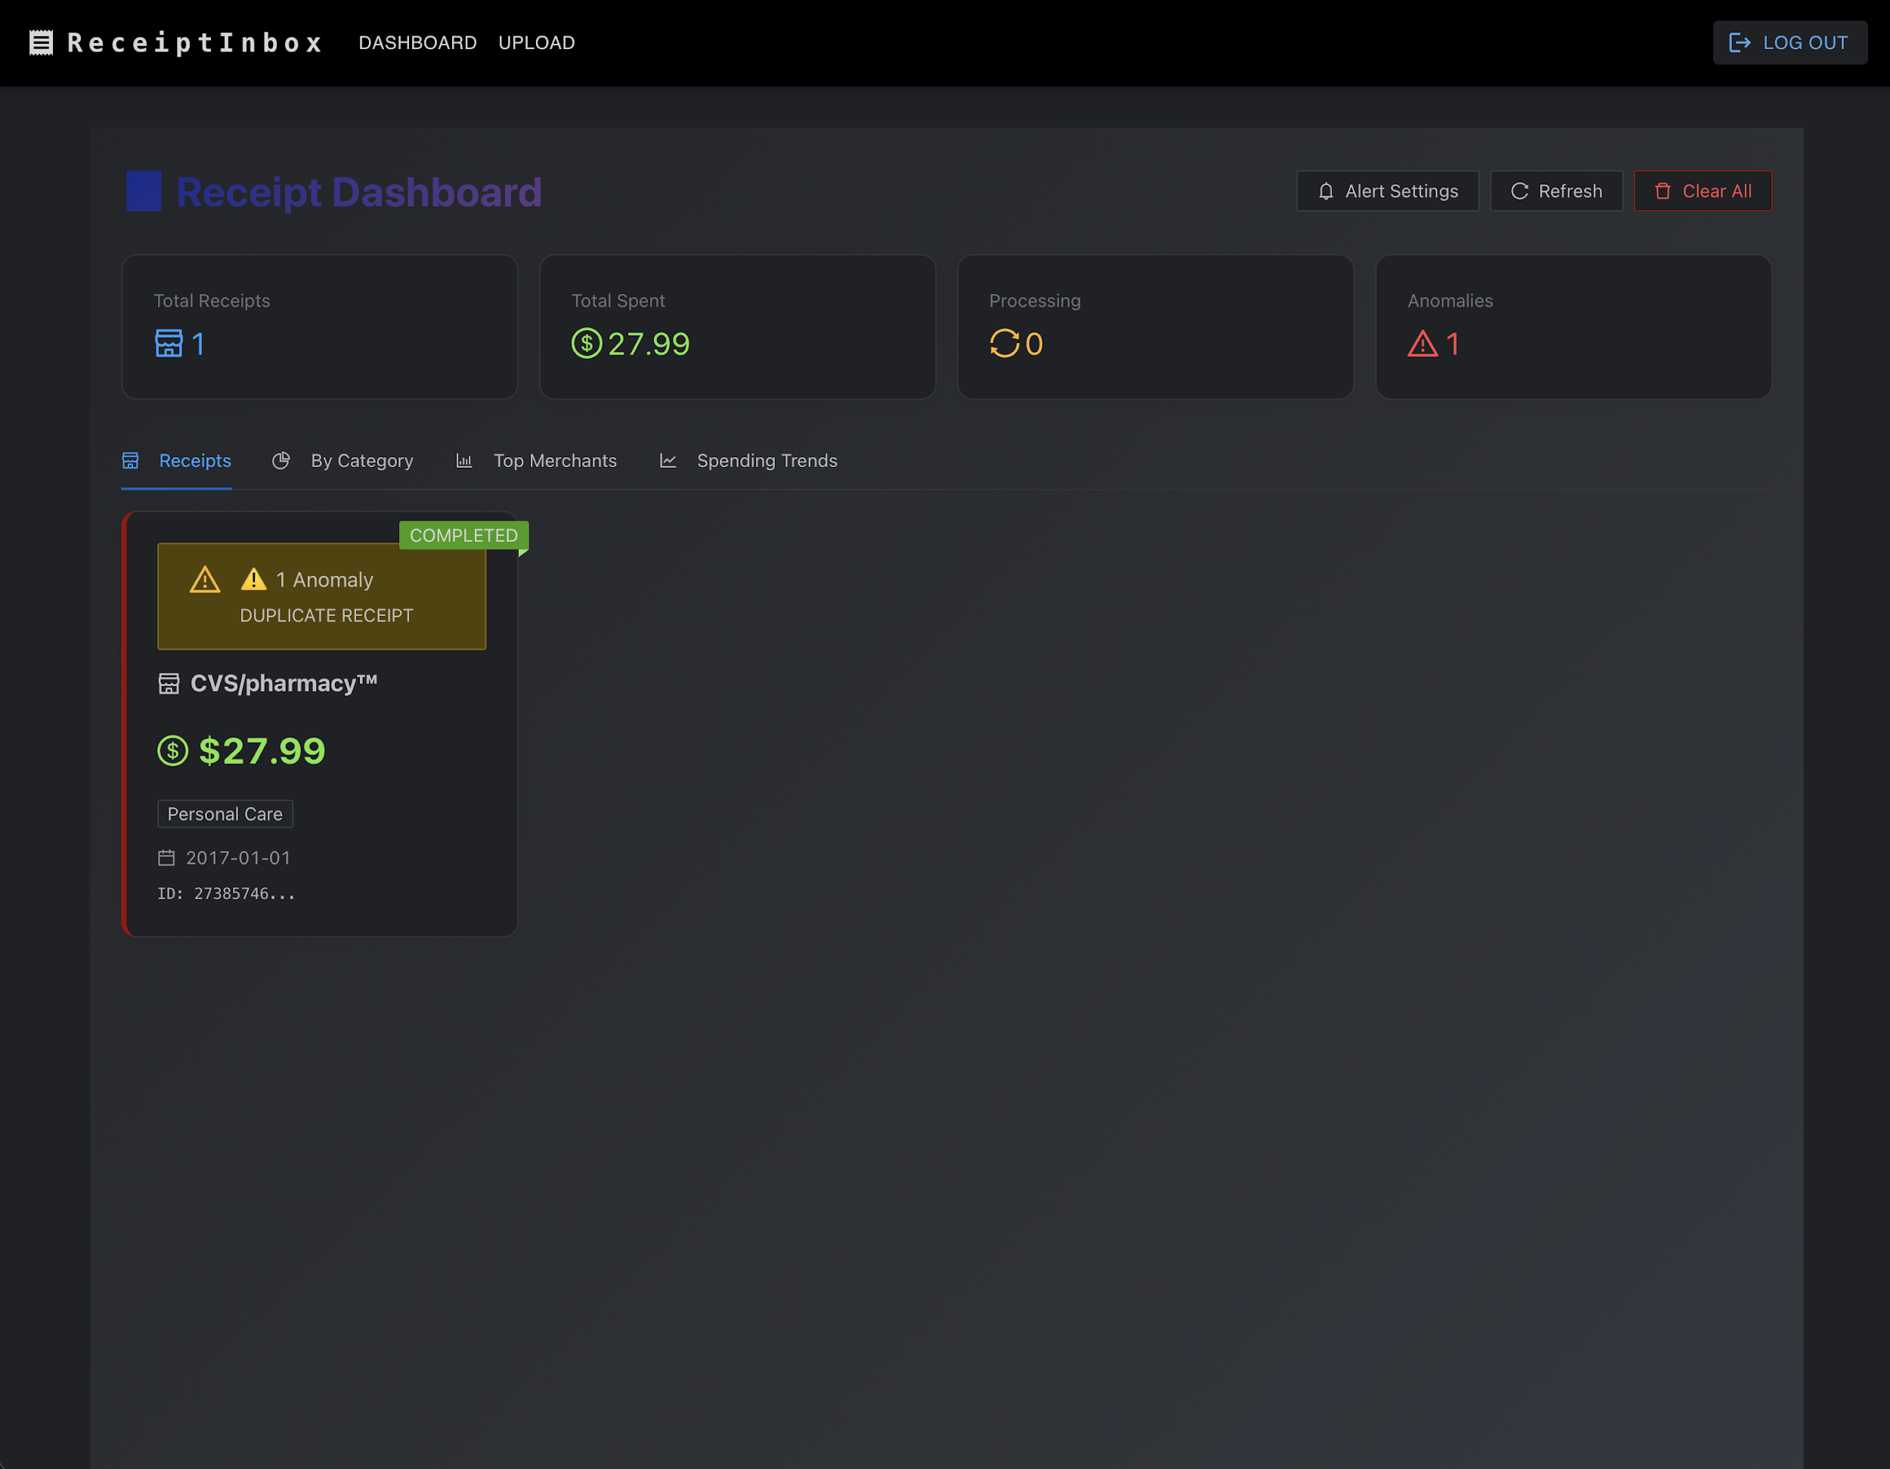
PAGE: UPLOAD, DASHBOARD
Allow users to upload receipts
Pop-up window to select file
Drag-and-Drop
User’s spending statistic
  Receipts
  By Category
  Top Merchants
  Spending Trends

Slide 14
BACKEND

Slide 15
BACKEND SUMMARY
Languages & Frameworks:
- Python 3.10
    - FastAPI: framework
    - AWS SAM: for IoC
    - JWT (jose library) for authentication validation
Database and Storage Strategy:
- DynamoDB: for both user and receipts tables
- Amazon S3: stores raw PDF and image files.
How Tasks are Triggered (Async Fan-out):
    Direct Upload→State Tracking→Queue Dispatch→Worker Trigger

Slide 16
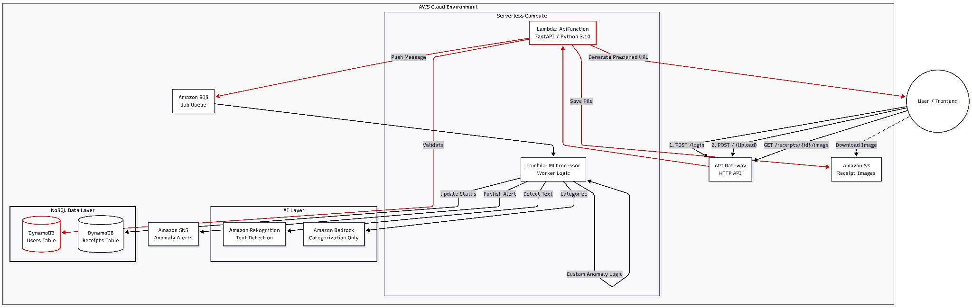
BACKEND SUMMARY
Figure: ReceiptInbox—Serverless-Receipt-Parser-Smart-Alerts Server Architecture

Slide 17
OUTSIDE DATA API – AWS TEXTRACT API
Source Name:
AWS AI Services (Amazon Rekognition & Amazon Bedrock)
What is the source:
Amazon Rekognition: Uses deep learning to detect and extract text from receipt images.
Bedrock: Generative AI service (LLM) used to interpret the text, categorize spending.

Slide 18
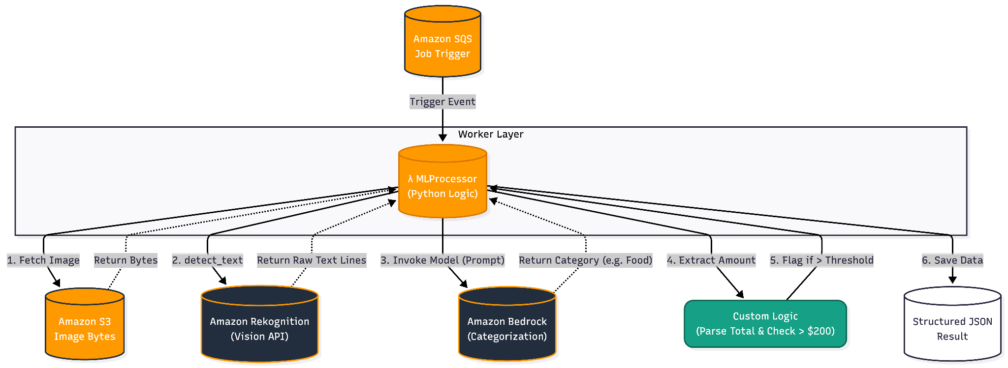
OUTSIDE DATA API – AWS TEXTRACT API
How to access and ingest the data

Slide 19
PERFORMANCE AND SCALABILITY
Serverless Scaling:
AWS Lambda auto-scales from 0 to 1,000+ users without config.
Async Decoupling:
SQS offloads heavy ML tasks; prevents API timeouts.
Optimized Bandwidth:
S3 Presigned URLs bypass backend for direct file download.
High-Speed Data:
DynamoDB provides consistent, single-digit ms latency at scale.
Observed Latency:
  Warm: < 500ms (Average response).
  Cold Start: ~2-3s (Runtime initialization).

Slide 20
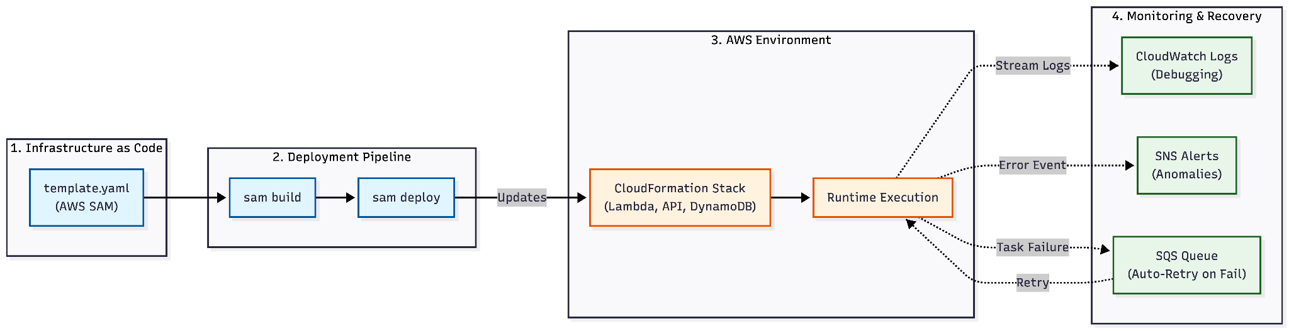
DEVOPS / SYSTEM OPERATIONS
Notes:
Infrastructure as Code (IaC):
Tool: AWS SAM (Serverless Application Model).
Benefit: Entire stack defined in one template.yaml.
Deployment Pipeline:
Process: Manual CLI trigger: sam build && sam deploy.
Target: Single stage deployment to us-east-1.
Monitoring & Alerts:
Logs: AWS CloudWatch.
Alerts: Amazon SNS sends email notifications.
Error Handling:
App Level: FastAPI handles schema validation & Auth errors.
System Level: SQS retries failed tasks; DynamoDB explicitly tracks FAILED job status.

Slide 21
MACHINE LEARNING

Slide 22
ML OVERVIEW
AWS Rekognition
  OCR: Extract text from uploaded receipt image
AWS Bedrock
  AI Categorization: classify spendings into 15 categories

Slide 23
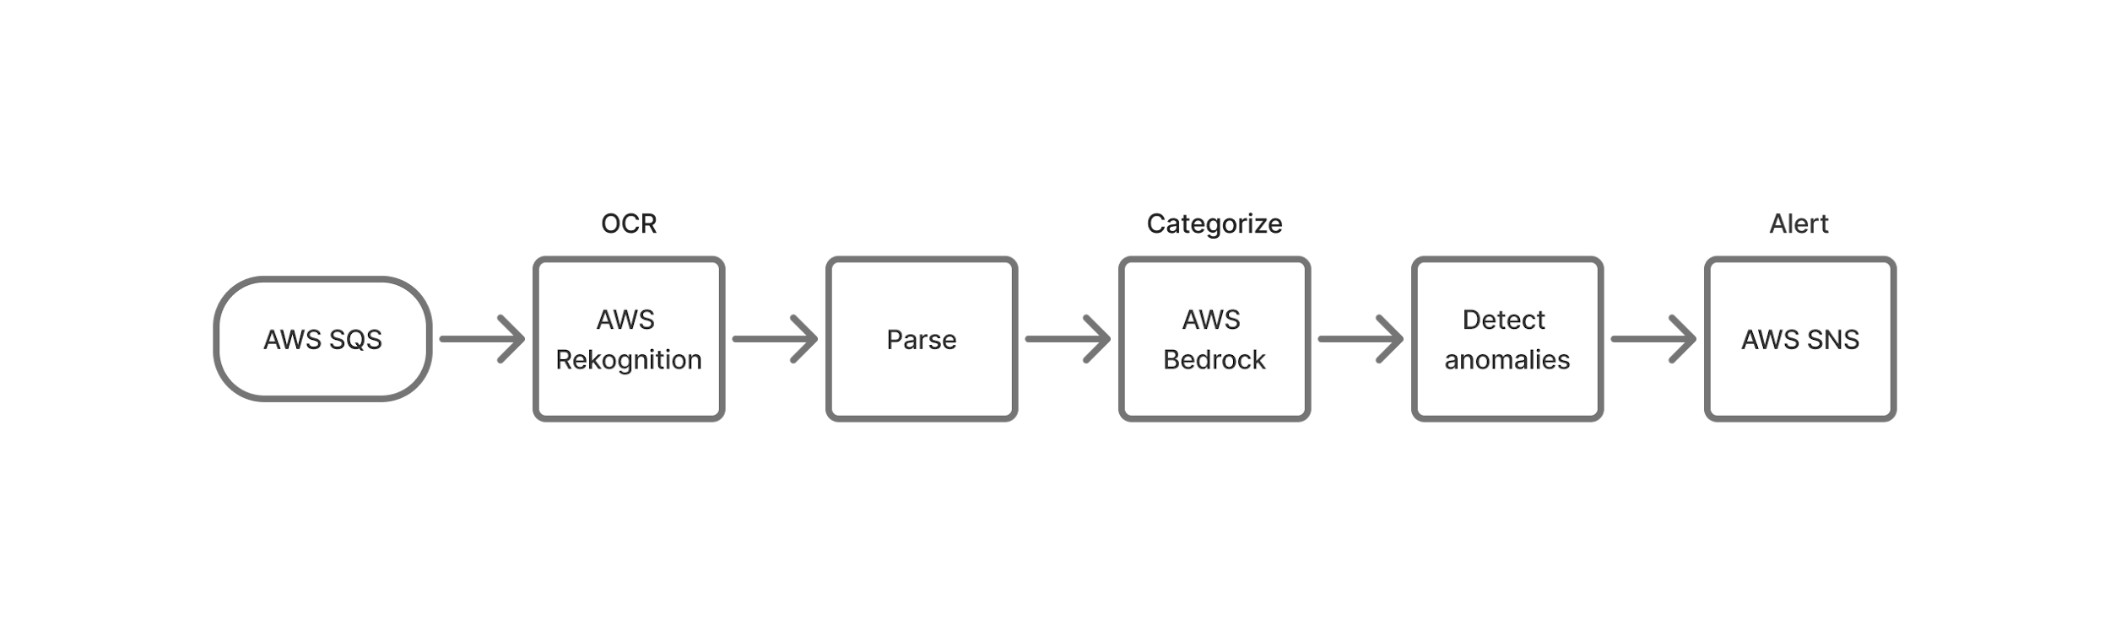
ML INTEGRATION
Data flow:

Slide 24
ML PERFORMANCE
OCR Accuracy: 70-85%
Categorization Accuracy: 90%+ (with Bedrock)
Processing Time: 15-20 seconds
Cost per Receipt: ~$0.001 (Rekognition + Bedrock + Lambda)

Slide 25
API

Slide 26
API SUMMARY
Type & Protocol
  HTTP API with CORS support.
Framework
  FastAPI: for auto-validation (Pydantic).
  Mangum Adapter: for native execution on AWS Lambda.
Architecture Role
  Stateless orchestrator connecting React Frontend to AWS services.
Key Design Pattern
  Asynchronous Handoff: Offloads heavy ML tasks to SQS to ensure low latency and prevent timeouts.

Slide 27
API SECURITY AND ACCESS
Authentication Mechanism:
  JWT (HS256) carried in the Authorization: Bearer header.
  Tokens expire after 30 minutes.
Credential Storage:
  Passwords are hashed by SHA256.
  Credentials stored in DynamoDB (Users Table).
Server-Side Verification:
  Protected routes validate the JWT signature on every request.
  Verified against the DynamoDB user partition key (username).
Notes:
Authentication Mechanism:
Stateless: JWT (HS256) carried in the Authorization: Bearer header.
Expiration: Tokens expire after 30 minutes.
Credential Storage:
Hashing: Pwd are hashed by SHA256.
Storage: Credentials stored in DynamoDB (Users Table).
Server-Side Verification:
Dependency Injection: Protected routes validate the JWT signature on every request.
Access Control: Verified against the DynamoDB user partition key (username).

Slide 28
API ENDPOINTS
POST /signup & /login
  Input: { email, password }
  Logic: Hashes password (SHA256) → Interacts with DynamoDB → Returns JWT Token
POST / (Receipt Upload)
  Function: Ingest & Dispatch.
  Logic: Saves image(S3)→Creates DynamoDB entry→Publishes job message to Amazon SQS ← receipt_id.
GET /receipts/{id}/image
  Function: Secure Viewing.
  Logic: Generates a short-lived S3 Presigned URL to securely display the receipt image.

Slide 29
IN CONCLUSION…

Slide 30
OUTCOMES AND RESULTS
The whole system has been successfully deployed and functions as expected
Token-based authentication flaws
  Token can be created or modified locally (browser localStorage)
OCR accuracy: 70-85% (image quality dependent)

